Slide 1

POPCORN BOX APP

Slide 2

INDEX
Basic Overview
Functionalities
Technologies Used
Flow Of Application
Roles
Challenges Faced
SonarQube Report
GitHub Implementation

Slide 3
Basic overview
POPCORN BOX APP
The Popcorn Box App is one of the most popular, because it has a very user-friendly interface. The vast digital collection can be navigated quickly, so there’s no need to spend time fruitlessly browsing unless you want to.
The key advantage of this app is that content can be accessible and stored for offline viewing later. This really is home cinema at its most convenient.

Slide 4

Functionalities
POPCORN BOX APP
Dynamic Home Page
Search Functionality
Dynamic Movies Page
Dynamic TV Shows Page
Dynamic Music Page
Rating Feature
Favorites Page
Media Player
Updates
User Dashboard
DRM
Notes:
All covered as per requirements.

Slide 5
Technologies used
Front-End
HTML
CSS
Bootstrap 5.0
RWD
Back-End
JS
jQuery
AXIOS Library
JSON-Server

Slide 6
Flow of application
Register
Login
Watch
Favorite
Logout

Slide 7
Roles
Siddharth: Login, Register, Music Player
Sumit: Movies, Shows, Music, Web Player, Database
Soham: Change Password, Rating, Sonar Analysis
Satvik: Search, Forgot Password
Tushar: Home Page, Favorite Function, Update Profile, DRM

Slide 8
Challenges faced
Login - Finding username if it is already present or not.
Rating – Updating Rating based on UserID and ContentID.
Search – Preventing multiple search results having same tags and names.
Integration – Integration of rating on movie cards.
Favorite – Managing favorites of a particular user.
POPCORN BOX APP

Slide 9
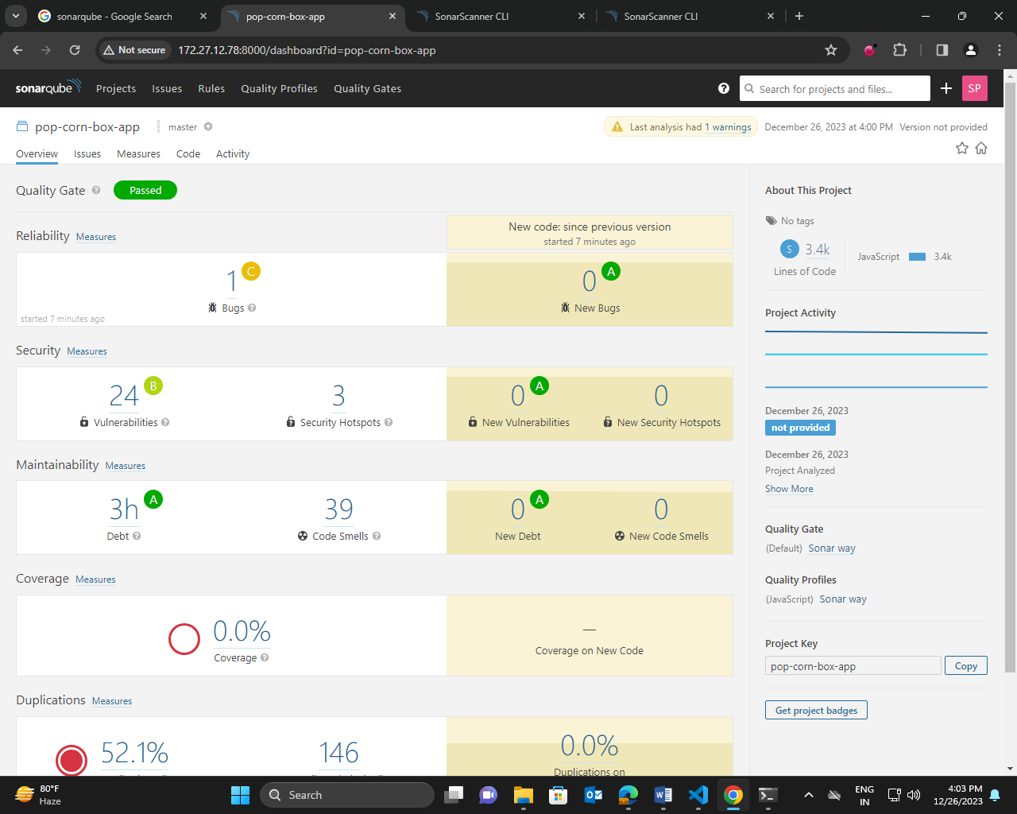
SonarQube report

Slide 10
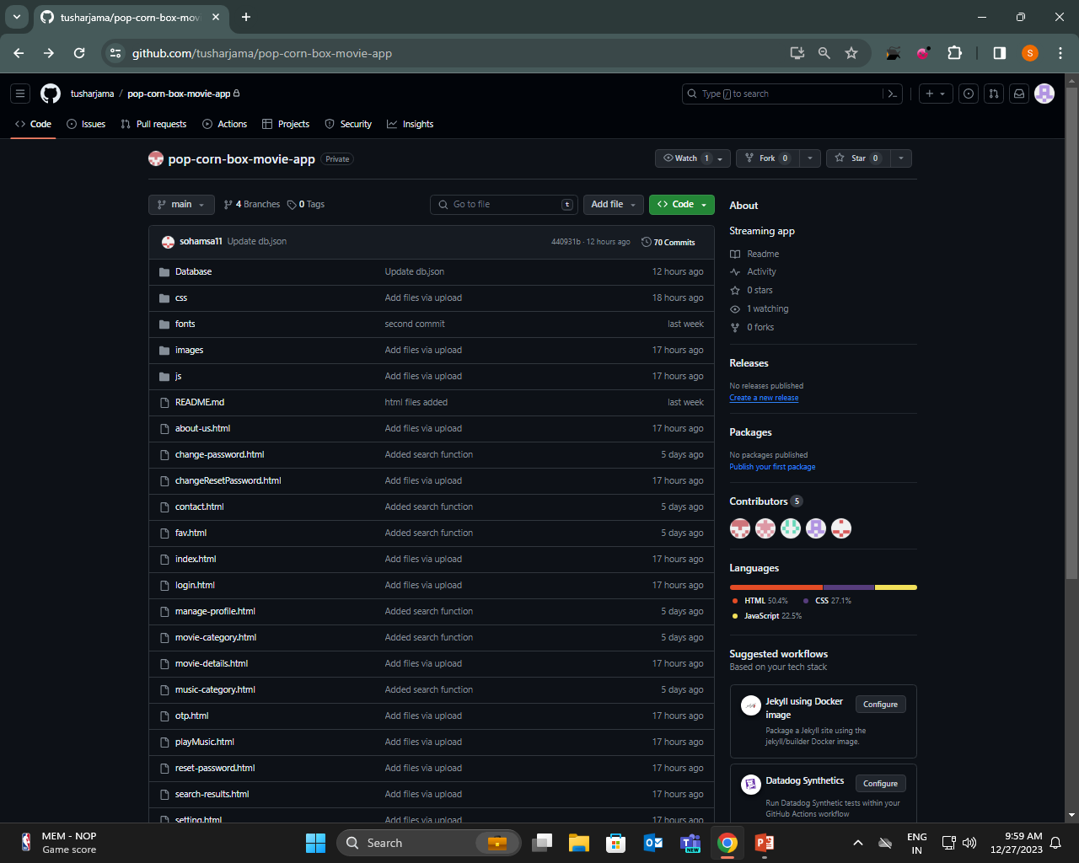
GitHub Implementation

Slide 11
THANK YOU

